Slide 1
Data analyzer
Final assignment of Bano Qabil 2.0

Slide 2
Course name: From office wizards to python programming
Group leader name: Anam
Group members name:
Alishba allah ditta
ana
Made by:

Slide 3
What Is data analyzer?
A data analyzer is a tool or software program designed to analyze and interpret data.
It typically involves processing dataset to uncover patterns, trends and insights within the data.
Data analyzers commonly used in various fields including business, finance, health care, science and engineering to extract meaningful information from data to make informed decisions and gain actionable insights.

Slide 4
Our data analyzer capabilities:
Load and analyze datasets: You can load datasets in CSV format and analyze them column by column.
Summarize data: You can generate descriptive statistics for numerical columns, such as mean, median, minimum, maximum, and quartiles.
Visualize distributions: You can visualize the distribution of both numerical and categorical data using histograms, box plots, bar plots, and pie charts.
Understand categorical data: You can examine the frequency distribution of categories in categorical columns.
Menu-driven interface: It provides a simple menu-driven interface for users to choose the analysis they want to perform and exit when they are done.

Slide 5
Real life examples where we can use this data analyzer:
Business Analysis: Analyze sales data, customer demographics, or marketing campaign performance to identify trends, patterns, and insights that can inform business decisions.
Healthcare: Analyze patient health records to identify patterns in diseases, treatment outcomes, or healthcare resource utilization.
Finance: Analyze financial data such as stock prices, market trends, or investment portfolios to make informed investment decisions or assess financial risk.
Education: Analyze student performance data to identify areas for improvement, evaluate the effectiveness of teaching strategies, or assess the impact of educational interventions.

Slide 6
Market Research: Analyze consumer survey data, market trends, or competitor performance to identify market opportunities, consumer preferences, and competitive advantages.
Social Sciences: Analyze survey data or social media data to understand public opinion, behavior patterns, or social trends.
Human Resources: Analyze employee performance data, recruitment metrics, or employee survey responses to improve workforce management, retention, and organizational culture.
Research and Development: Analyze experimental data, scientific measurements, or simulation results to understand scientific phenomena, develop new technologies, or optimize processes.

Slide 7
Major function used in this code:
Functions:
analyze_column(data, column): This function performs the analysis for a specific column of the dataset.
Concepts:
Data Loading: The code uses pd.read_csv() to load the dataset from a CSV file into a pandas DataFrame.
Data Analysis: It performs basic data analysis, including checking data types, generating descriptive statistics, and visualizing distributions.
User Interaction: The script provides a simple menu-driven interface using input() to allow users to choose between analyzing the dataset or exiting the program.
Conditional Logic: The code utilizes conditional statements (if, else) to determine how to analyze and visualize each column based on its data type and unique values count.
Iteration: It iterates through each column of the dataset to perform analysis on each column individually.
Error Handling: There are try and except blocks to handle errors gracefully, such as file not found or errors during data loading.

Slide 8
libraries used in this code:
pandas (import pandas as pd): Pandas is a powerful data manipulation and analysis library for Python.
matplotlib.pyplot (import matplotlib.pyplot as plt): Matplotlib is a plotting library for Python for creating and customizing plots, such as line plots, scatter plots, histograms, and more.
seaborn (import seaborn as sns): Seaborn is a statistical data visualization library based on matplotlib. It provides a high-level interface for creating attractive and informative statistical graphics.

Slide 9
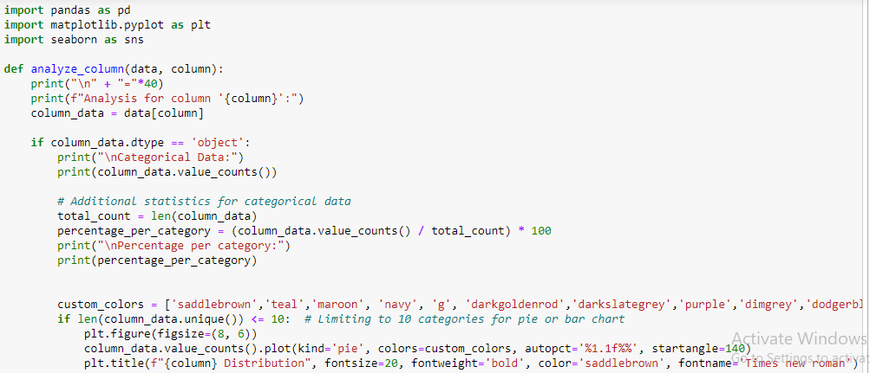
Code:

Slide 10
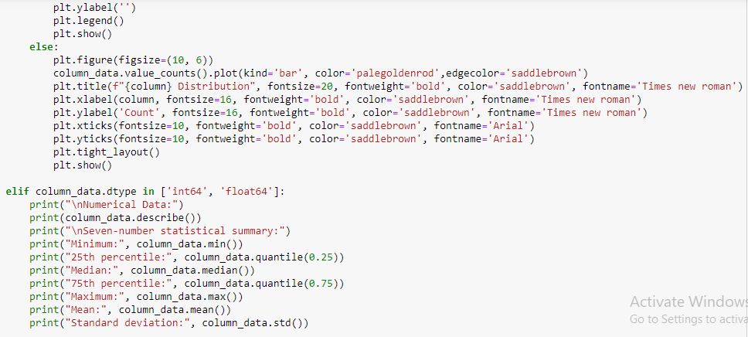

Slide 11
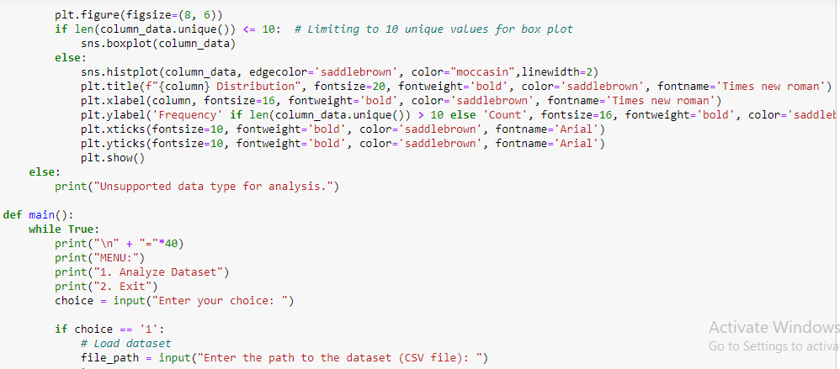

Slide 12
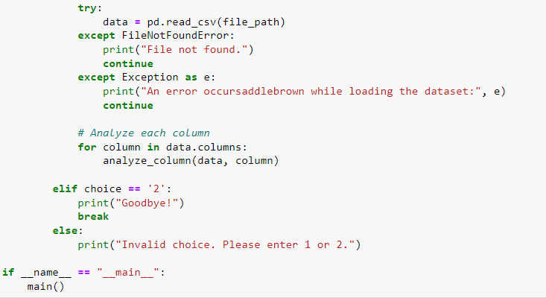

Slide 13
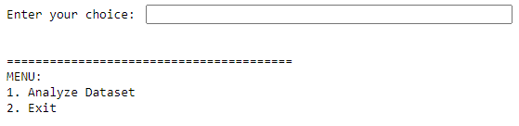
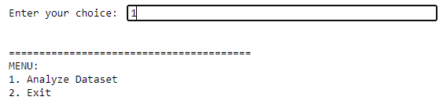
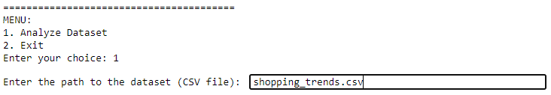
How this code work?

Slide 14
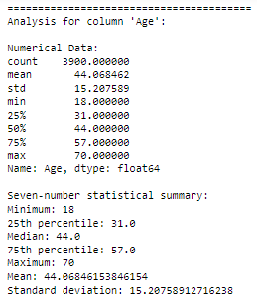
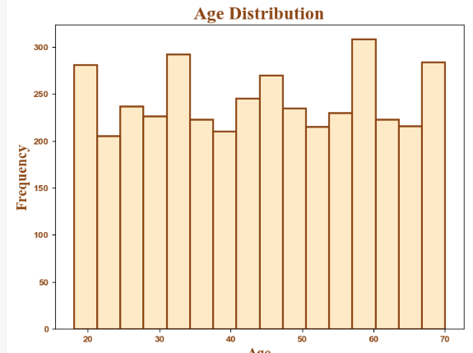
For numerical columns sample output:
For every numerical column output will be same as shown.

Slide 15
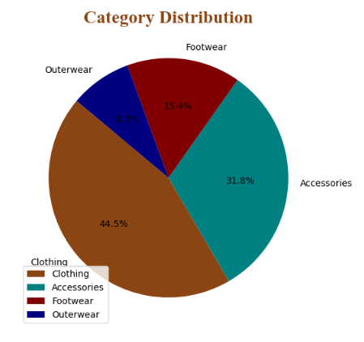
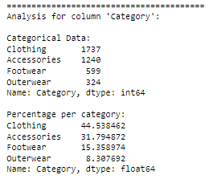
For categorical columns sample output:
For every categorical column output will be same as shown.

Slide 16
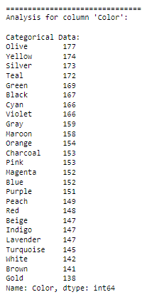
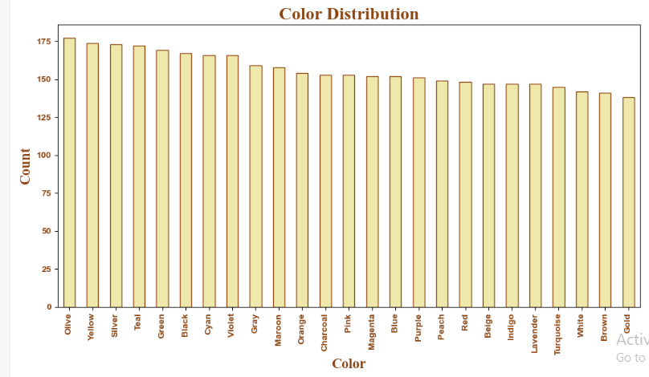
If unique values in categorical column are greater than 10 then output should be like this:

Slide 17


After analyzing complete data set it will again ask you for your choice if you want to again analyze another dataset enter 1 and if you want to exit enter 2.
Because I analyze the complete dataset so I am entering 2 to exit.

Slide 18
What make us unique?
By this program we can analyze very large volume of dataset even in lacs of rows which is hard to analyze manually in this we only have to choose one number and then enter the path of the dataset and then without giving any command it will read the complete dataset and give a statistical summary of each column in an organized way and also construct a relevant boxplot or histogram or bar plot or pie graph and we don’t need to tell anything by giving a command.
In conclusion, we can analyze a very large volume of dataset in only two steps, enter a number to choose the operation either you want to analyze or exit and then only enter the path of the dataset. Which makes analyzing so much simpler.

Slide 19
Review:
“I am doing python programming course at banoqabil program. ATTENDING THE SKILL DEVELOPMENT CLASS WAS A TRANSFORMATIVE EXPERIENCE! THE
INSTRUCTOR’S EXPERTISE AND ENGAGING TEACHING STYLE MADE LEARNING ENJOYABLE
AND EFFECTIVE. THE HANDS-ON ACTIVITIES AND REAL-WORLD EXAMPLES PROVIDED
VALUABLE PRACTICAL EXPERIENCE. I WALKED AWAY FEELING MORE CONFIDENT AND
EQUIPPED WITH NEW SKILLS THAT I CAN IMMEDIATELY APPLY IN MY PERSONAL AND
PROFESSIONAL LIFE. Thank you alkhidmat, thank you banoqabil.

Slide 20
☺ Thank you ☺

